Slide 1
CSS (Cascading Style Sheets

Slide 2
CSS
CSS is the language we use to style an HTML document.
CSS describes how HTML elements should be displayed.
Cascading means that a style applied to a parent element and it also apply to all children element with in parent.

Slide 3
CSS Types
CSS can be added to HTML documents in 3 ways:
Inline - by using the style attribute inside HTML elements
Internal - by using a <style> element in the <head> section
External - by using a <link> element to link to an external CSS file

Slide 4
Inline CSS
An inline CSS is used to apply a unique style to a single HTML element.
An inline CSS uses the style attribute of an HTML element.
Example
<h1 style="color:blue;">A Blue Heading</h1>

Slide 5
Internal CSS
An internal CSS is used to define a style for a single HTML page.
An internal CSS is defined in the <head> section of an HTML page, within a <style> element.
Example:
<head> <style> body {background-color: powderblue;} h1 {color: blue;} p {color: red;} </style> </head>

Slide 6
CSS Selectors
CSS selectors are used to "find" (or select) the HTML elements you want to style.
The CSS element Selector:
The element selector selects HTML elements based on the element name.
Example:
p { text-align: center; color: red; }

Slide 7
The CSS id Selector
The id selector uses the id attribute of an HTML element to select a specific element.
The id of an element is unique within a page, so the id selector is used to select one unique element!
To select an element with a specific id, write a hash (#) character, followed by the id of the element.
Example:
#para1 { text-align: center; color: red; }

Slide 8
CSS class Selector
The CSS class Selector
The class selector selects HTML elements with a specific class attribute.
To select elements with a specific class, write a period (.) character, followed by the class name.
Example:
.center { text-align: center; color: red; }

Slide 9
CSS Universal Selector
The CSS Universal Selector
The universal selector (*) selects all HTML elements on the page.
Example:
* { text-align: center; color: blue; }

Slide 10
CSS Grouping Selector
The CSS Grouping Selector
The grouping selector selects all the HTML elements with the same style definitions.
Look at the following CSS code (the h1, h2, and p elements have the same style definitions):
Example:
h1, h2, p { text-align: center; color: red; }

Slide 11
External CSS
External CSS
An external style sheet is used to define the style for many HTML pages.
To use an external style sheet, add a link to it in the <head> section of each HTML page:
Example:
<head> <link rel="stylesheet" href="styles.css"> </head>
The external style sheet can be written in any text editor. The file must not contain any HTML code, and must be saved with a .css extension.

Slide 12
CSS Comments
CSS Comments
Comments are used to explain the code, and may help when you edit the source code at a later date.
Comments are ignored by browsers.
A CSS comment is placed inside the <style> element, and starts with /* and ends with */:

Slide 13
<!DOCTYPE html>
<html>
<head>
<style>
/* This is a single-line comment */
/* This is
a multi-line
comment */
p {
color: red;
}
</style>
</head>
<body>
<p>Hello World!</p>
<p>This paragraph is styled with CSS.</p>
<p>CSS comments are not shown in the output.</p>
</body>
</html>
Notes:
Int a =10; /*singl
Nbhj
Jkhkjhk
bbh
*/

Slide 14
CSS Colors
Colors are specified using predefined color names, or RGB, HEX, HSL, RGBA, HSLA values.
CSS Color Names
In CSS, a color can be specified by using a predefined color name:
Orange
DodgerBlue
MediumSeaGreen
Gray
SlateBlue
Violet
LightGray

Slide 15
RGB:
In CSS, a color can be specified as an RGB value, using this formula:
rgb(red, green, blue)
Each parameter (red, green, and blue) defines the intensity of the color between 0 and 255.
To display black, set all color parameters to 0, like this: rgb(0, 0, 0)
EX:
<h2 style="background-color:rgb(255, 0, 0);">rgb(255, 0, 0)</h2>

Slide 16
HEX:
HEX Value
In CSS, a color can be specified using a hexadecimal value in the form:
#rrggbb
Where rr (red), gg (green) and bb (blue) are hexadecimal values between 00 and ff (same as decimal 0-255).
For example, #ff0000 is displayed as red, because red is set to its highest value (ff) and the others are set to the lowest value (00).
To display black, set all values to 00, like this: #000000.
To display white, set all values to ff, like this: #ffffff.
Ex:
<h2 style="background-color:#ff0000;">#ff0000</h2>

Slide 17
HSL Value
In CSS, a color can be specified using hue, saturation, and lightness (HSL) in the form:
hsl(hue, saturation, lightness)
Hue is a degree on the color wheel from 0 to 360. 0 is red, 120 is green, and 240 is blue.
Saturation is a percentage value, 0% means a shade of gray, and 100% is the full color.
Lightness is also a percentage, 0% is black, 50% is neither light or dark, 100% is white
EX:
<h2 style="background-color:hsl(0, 100%, 50%);">hsl(0, 100%, 50%)</h2>

Slide 18
CSS Borders
The CSS border properties allow you to specify the style, width, and color of an element's border.
CSS Border Style
The border-style property specifies what kind of border to display.
The following values are allowed:
dotted - Defines a dotted border
dashed - Defines a dashed border
solid - Defines a solid border
double - Defines a double border
groove - Defines a 3D grooved border. The effect depends on the border-color value
ridge - Defines a 3D ridged border. The effect depends on the border-color value
inset - Defines a 3D inset border. The effect depends on the border-color value
outset - Defines a 3D outset border. The effect depends on the border-color value
none - Defines no border
hidden - Defines a hidden border

Slide 19
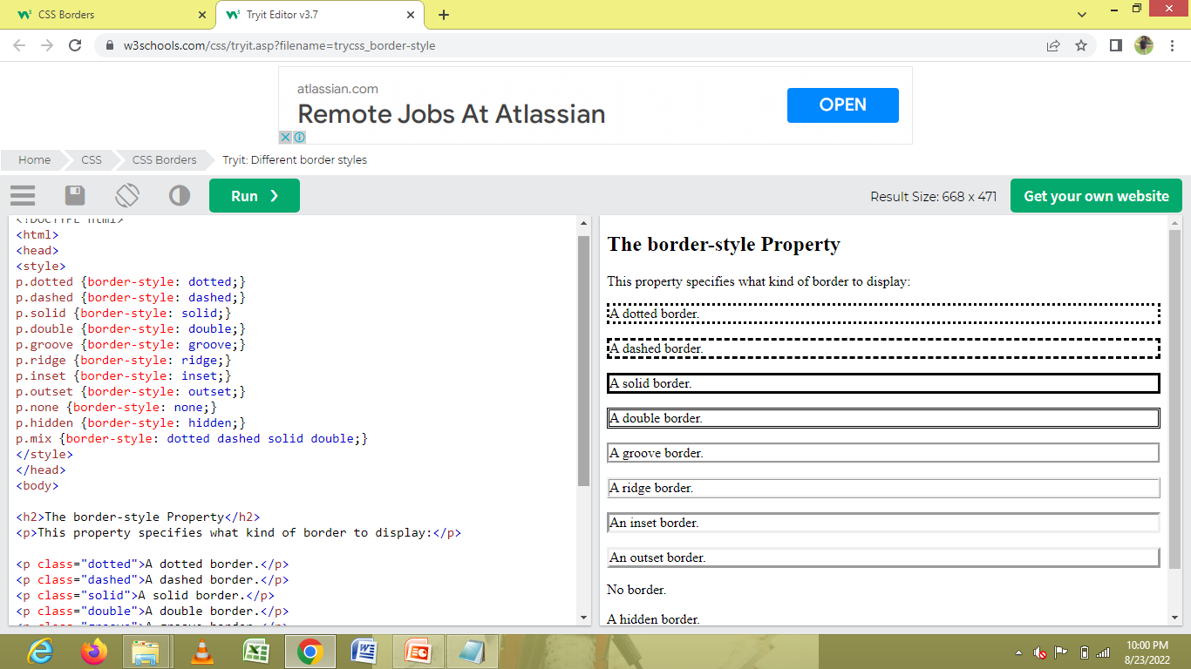

Slide 20
CSS Border Width
The border-width property specifies the width of the four borders.
The width can be set as a specific size (in px, pt, cm, em, etc) or by using one of the three pre-defined values: thin, medium, or thick:
border-width: 5px;

Slide 21
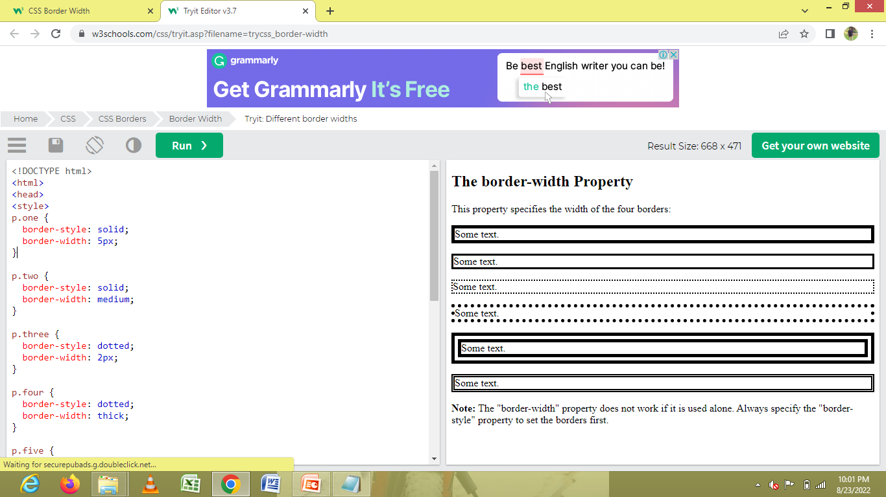

Slide 22
CSS Border Color
The border-color property is used to set the color of the four borders.
The color can be set by:
name - specify a color name, like "red"
HEX - specify a HEX value, like "#ff0000"
RGB - specify a RGB value, like "rgb(255,0,0)"
HSL - specify a HSL value, like "hsl(0, 100%, 50%)"
transparent
Note: If border-color is not set, it inherits the color of the element.

Slide 23
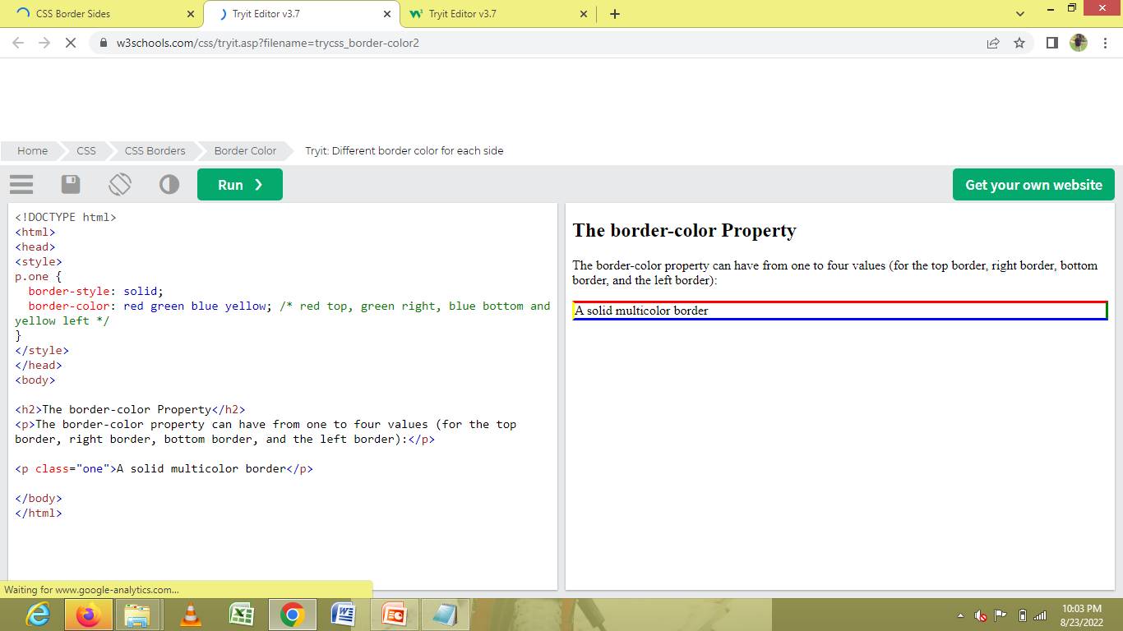

Slide 24
CSS Border - Individual Sides
From the examples on the previous pages, you have seen that it is possible to specify a different border for each side.
In CSS, there are also properties for specifying each of the borders (top, right, bottom, and left):

Slide 25
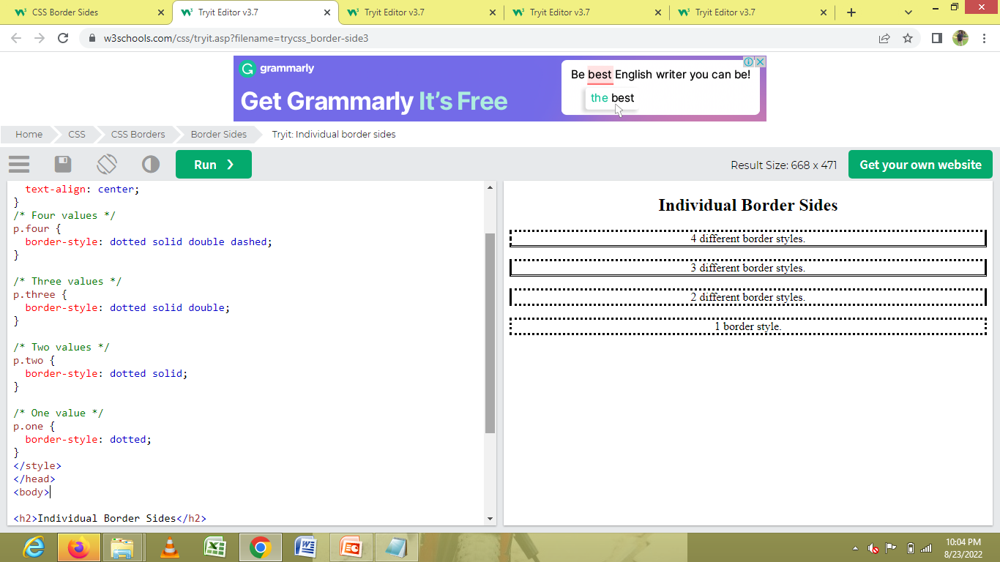

Slide 26
CSS Border - Shorthand Property
Like you saw in the previous page, there are many properties to consider when dealing with borders.
To shorten the code, it is also possible to specify all the individual border properties in one property.
The border property is a shorthand property for the following individual border properties:
border-width
border-style (required)
border-color

Slide 27
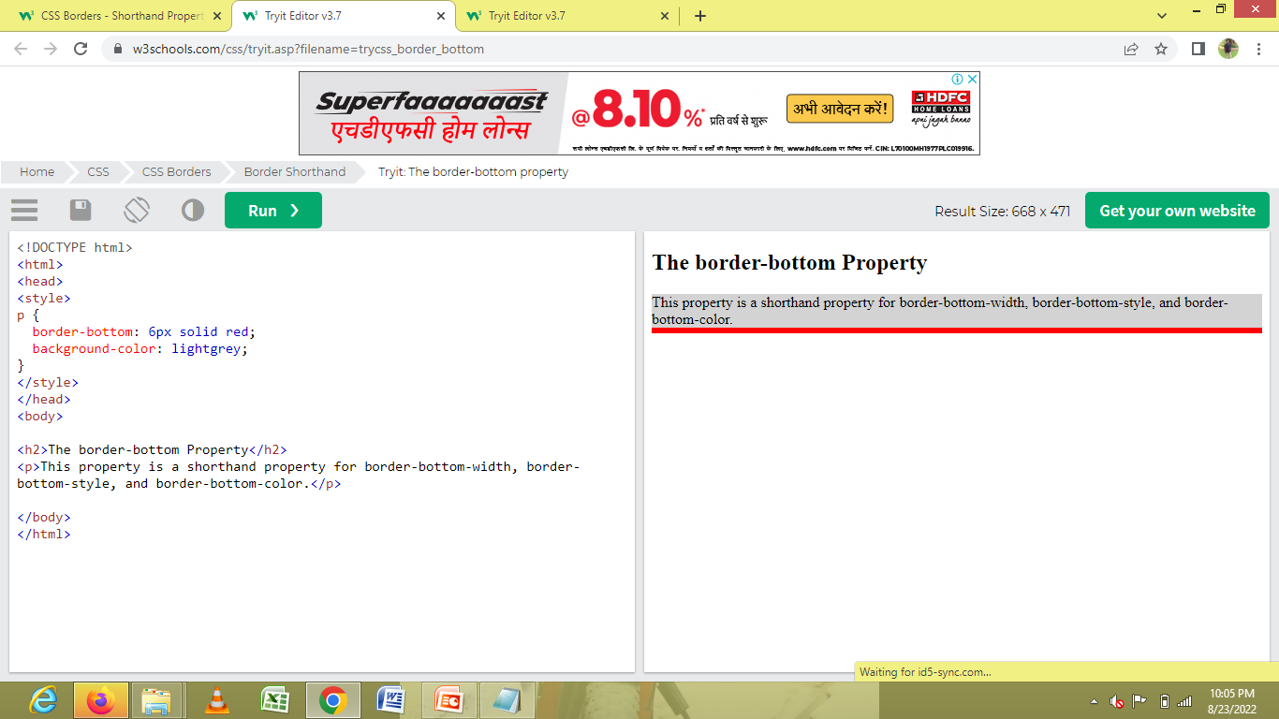

Slide 28
CSS Rounded Borders
The border-radius property is used to add rounded borders to an element:

Slide 29
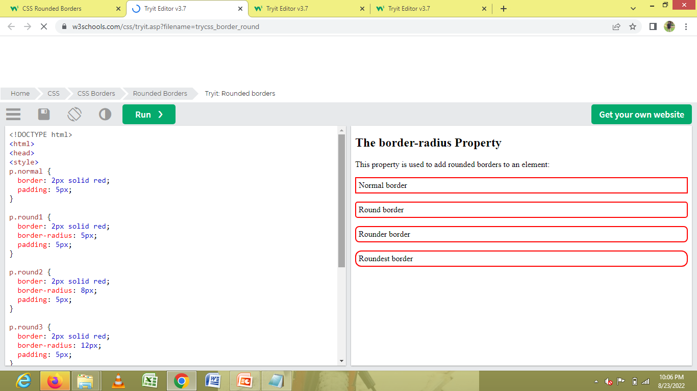

Slide 30
CSS Margins
Margins are used to create space around elements, outside of any defined borders.
he CSS margin properties are used to create space around elements, outside of any defined borders.
With CSS, you have full control over the margins. There are properties for setting the margin for each side of an element (top, right, bottom, and left).
Margin - Individual Sides
CSS has properties for specifying the margin for each side of an element:
margin-top
margin-right
margin-bottom
margin-left

Slide 31
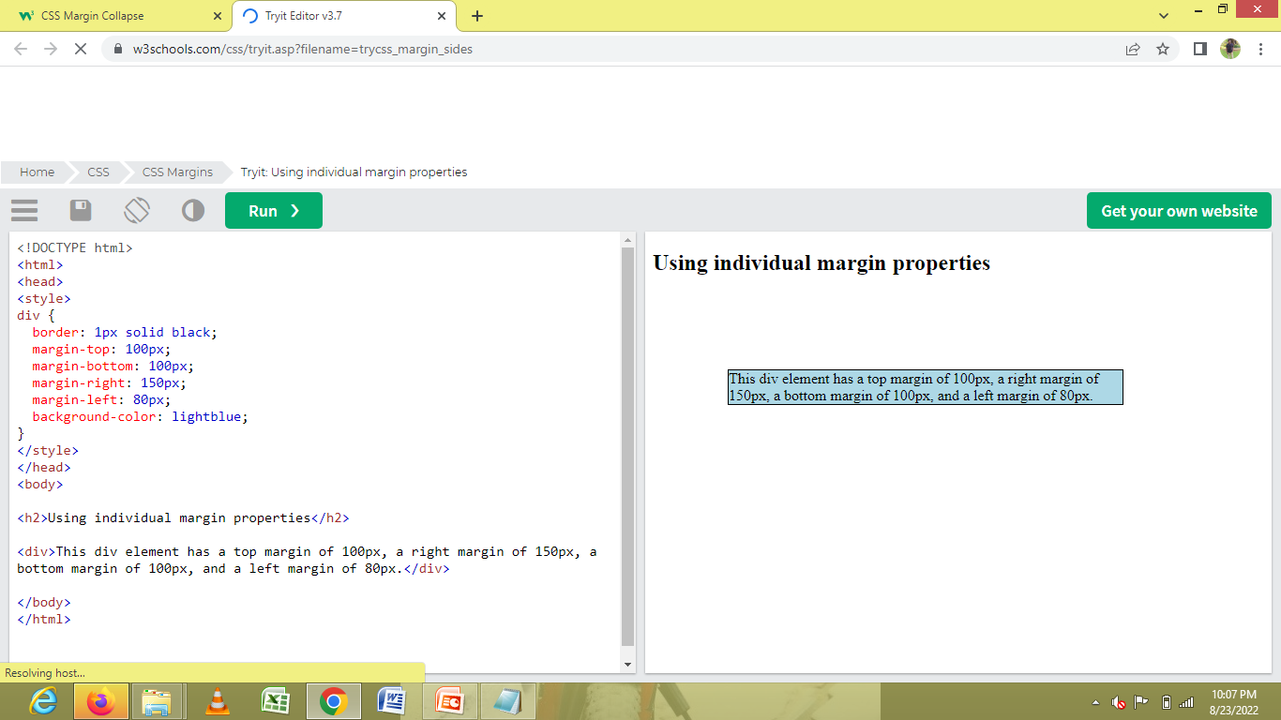

Slide 32
CSS Padding
The CSS padding properties are used to generate space around an element's content, inside of any defined borders.
With CSS, you have full control over the padding. There are properties for setting the padding for each side of an element (top, right, bottom, and left).
Padding - Individual Sides
CSS has properties for specifying the padding for each side of an element:
padding-top
padding-right
padding-bottom
padding-left

Slide 33
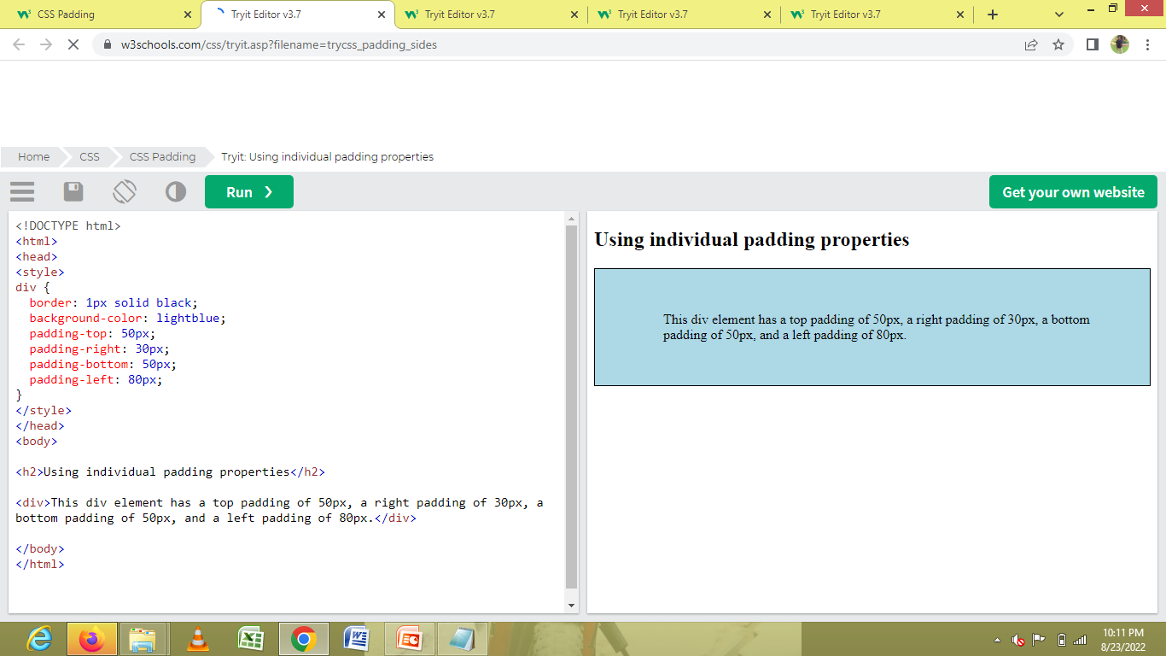

Slide 34
CSS Box Model
In CSS, the term "box model" is used when talking about design and layout.
The CSS box model is essentially a box that wraps around every HTML element. It consists of: margins, borders, padding, and the actual content. The image below illustrates the box model:

Slide 35
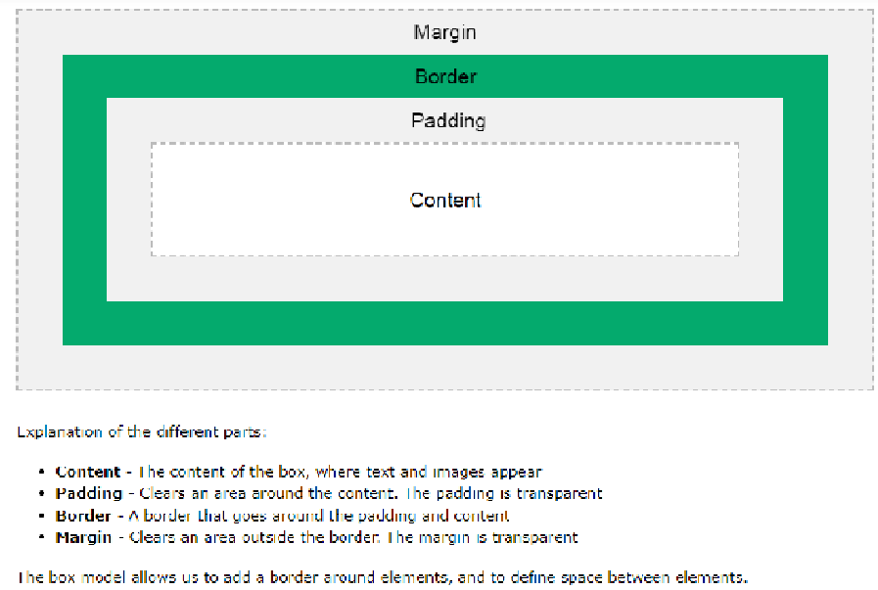

Slide 36
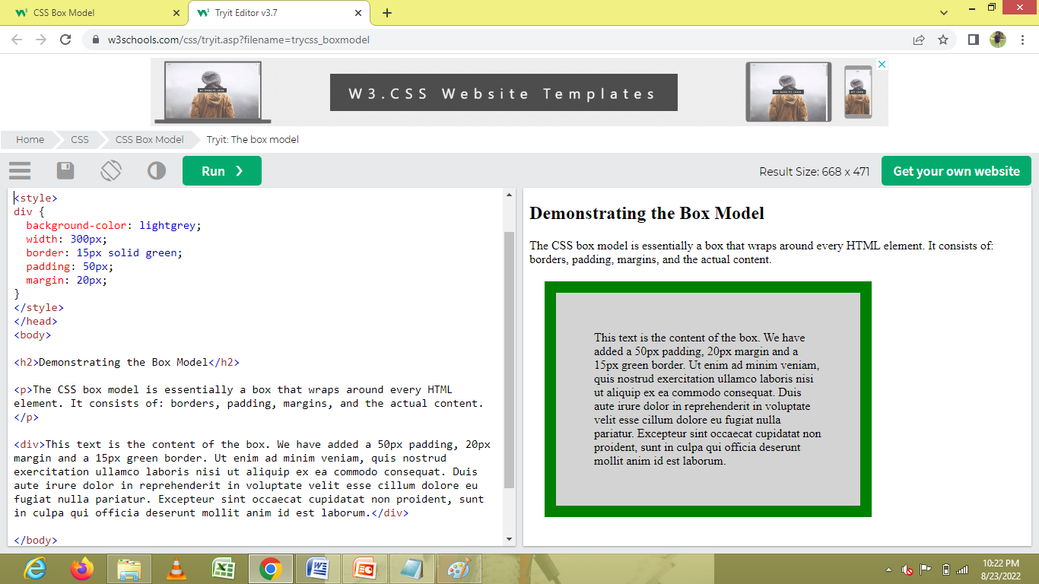

Slide 37
CSS Text
This text is styled with some of the text formatting properties. The heading uses the text-align, text-transform, and color properties. The paragraph is indented, aligned, and the space between characters is specified. The underline is removed from this colored "Try it Yourself" link.

Slide 38
Text-Color
The color property is used to set the color of the text. The color is specified by:
a color name - like "red"
a HEX value - like "#ff0000"
an RGB value - like "rgb(255,0,0)“
Text Color and Background Color
we define both the background-color property and the color property:

Slide 39
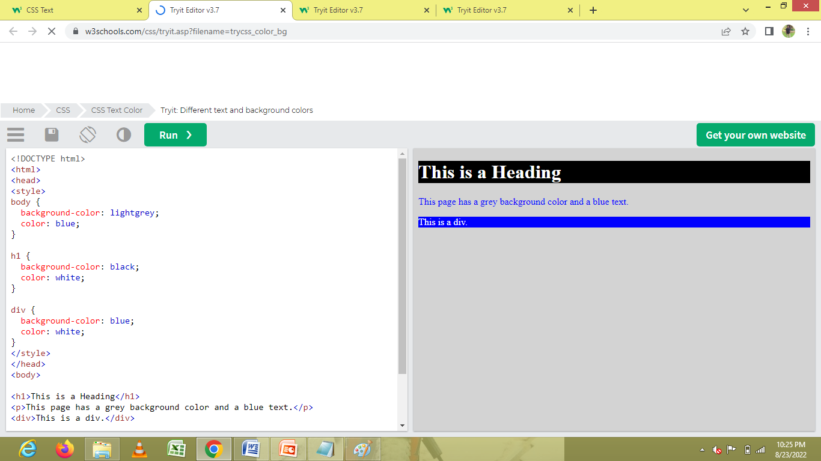

Slide 40
Text Transformation
The text-transform property is used to specify uppercase and lowercase letters in a text.
p.uppercase { text-transform: uppercase; } p.lowercase { text-transform: lowercase; } p.capitalize { text-transform: capitalize; }

Slide 41
